Slide 1
SHOW ME YOUR MEDS …PLEASE?
Deb Gompertz, Complex Care GP
Somerset Foundation Trust

Slide 2
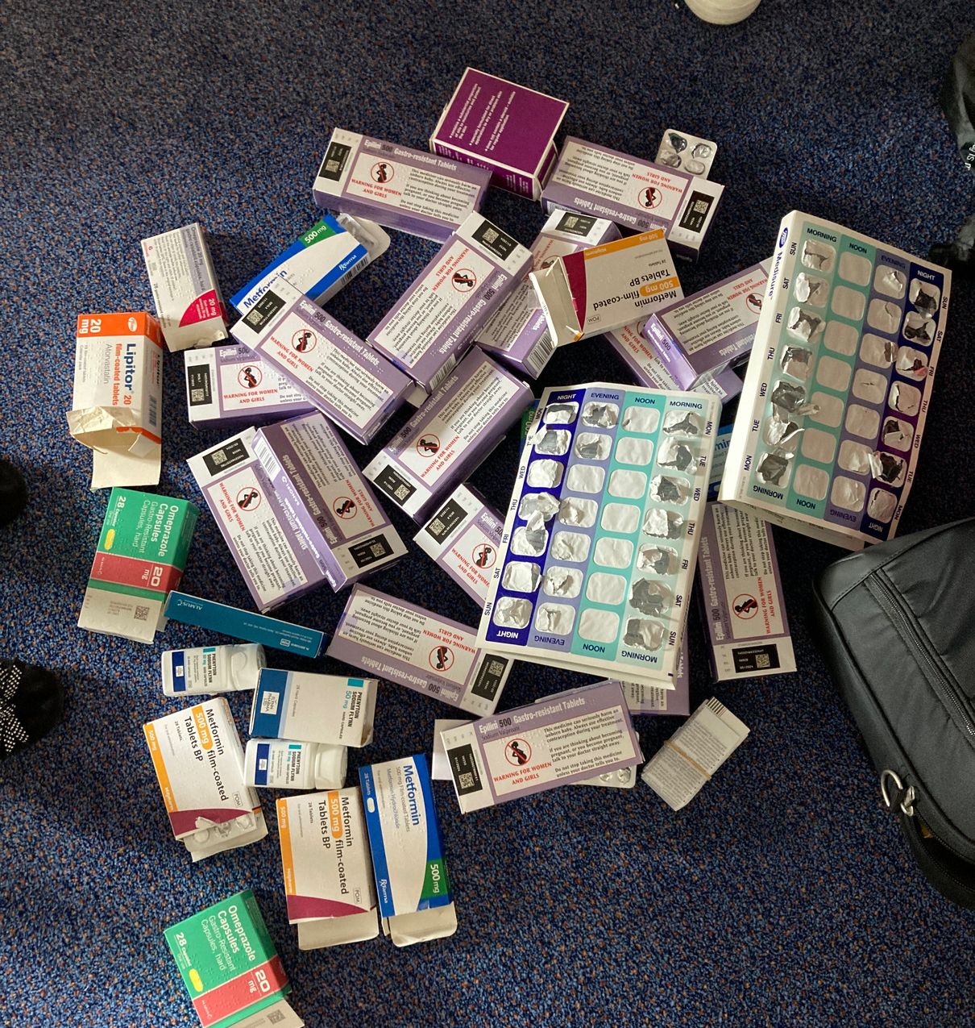
Reduction in medicines waste
Individualised care
Environmental and cost saving benefits

Slide 3
PART 1
Community: 12 weeks
1047 individual months of prescriptions
1693 Kg avoidable carbon emissions
5417 miles in UK petrol car

Slide 4
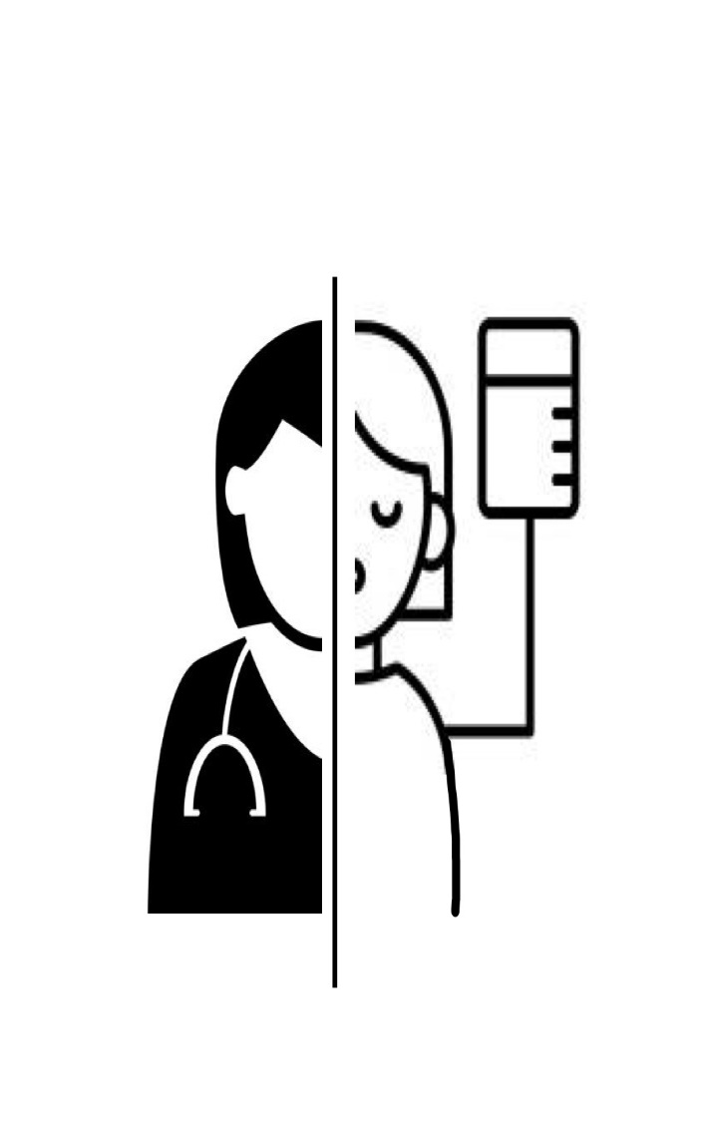
PERSON
Holistic care
Shared decision making
Cognitive impairment
identification
HEALTH/SOCIAL CARE
Treatment long term conditions
Simplification of medication regimes
Cost

Slide 6
Part 2 – Retirement Village
Replicate
Populations most benefit
Proactive

Slide 7
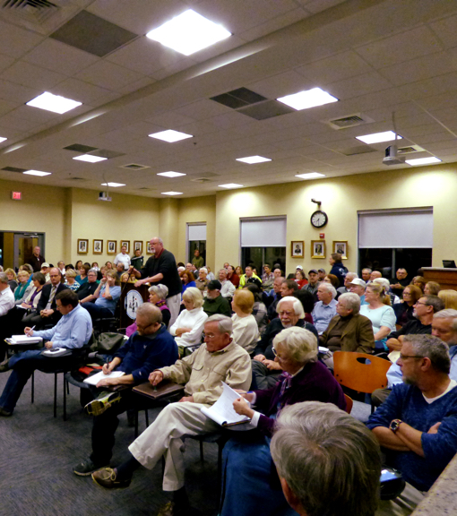
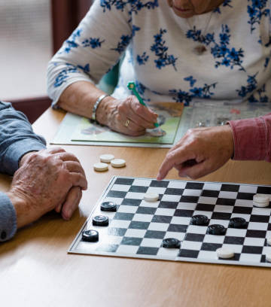

Slide 8
Incidence of non-adherence
People receiving visits in the community | 25%
Retirement village | 11%
Medically optimised ward (Assessed as needing follow up) | 80%

Slide 9
Complex care in the community (original study) 12 weeks
1047 individual months of prescription
1693Kg avoidable carbon emission
Retirement village (part 2) 6 weeks
10.3 kg weight of unpackaged medicines collected
515 individual months of prescriptions estimated not taken
846.5Kg estimated avoidable carbon emission

Slide 10
PART 3 – Somerset
Community Teams
Medicine Flow
Teaching-resources

Slide 11
FUTURE
Collaborative working
Structured Medication Reviews
Single prescribing document

Slide 12
Cost to the ENVIRONMENT
Cost to PEOPLE
Cost to NHS

